Slide 1
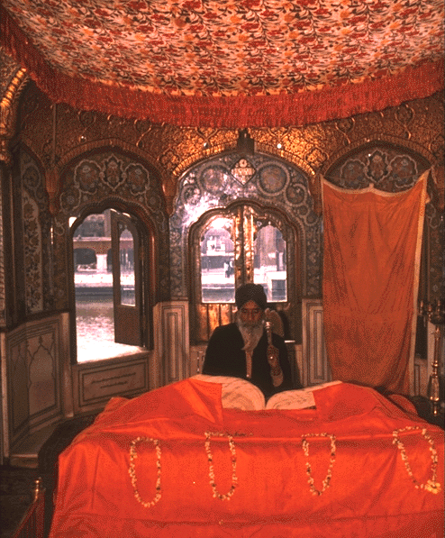
FUNDAMENTALS OF SIKHISM

Slide 2
CONCEPT OF GURU IN SIKHISM:
The Word is Guru." God anointed Guru Nanak with His Word, His Wisdom (Logos), and the Guru's whole personality was Word-personified.
The Guru made it very clear that his human body was not the Guru, and the mere outward glimpse of the Guru, or the outward profession of faith in him, could not bring the disciple close to the Guru.
The light of the Word within his heart was the real Guru and the disciple should approach him with a receptive mind to receive His Light.

Slide 3
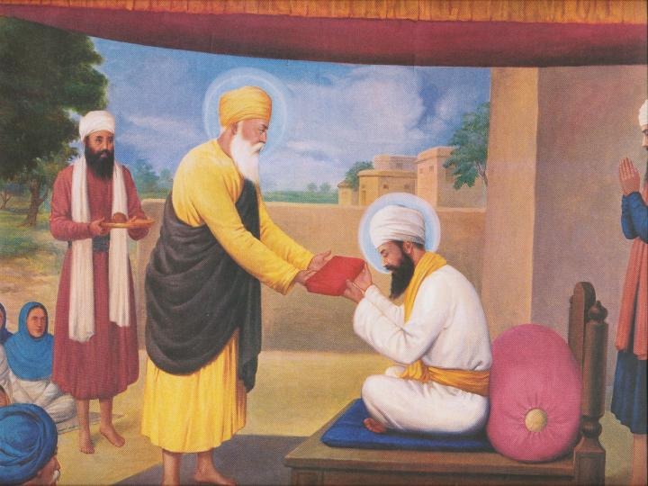
From the moment of its initiation by Guru Nanak to its consecration by the tenth Master, Guru Gobind Singh, a period of 239 years, Sikhism acquired its holy scripture, signs and symbols, and unmistakable form or stance.
Transformation from one Guru to the other happened in the same way as one lamp were to lit from another.
The holy transformation of ten Gurus is recognized as ONE, since all of them came from the same Divine Flame in continuity of the same Divine Mission.
Gurgadi being given to Guru Angad dev ji

Slide 4
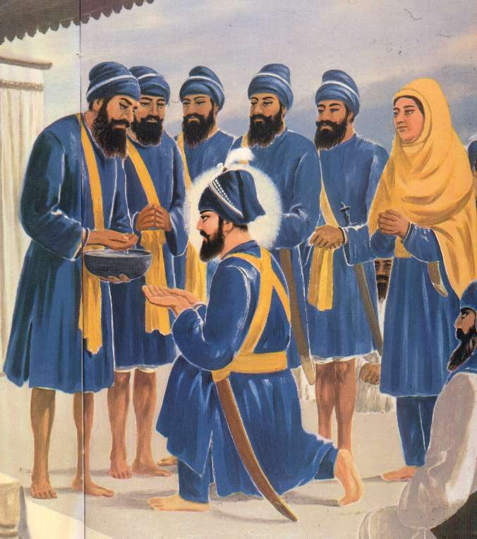
BAPTISM IN SIKHISM:
A Sikh has to take Pauhal or Amrit, from the Five Beloved Ones (Panj Pyare), then he becomes of the Guru or Guruwala.
Without baptism a Sikh remains without Guru or Nigura.
After baptism, through constant devotion and heart felt love to the order of the Guru in every walk of life, the disciple seeks the Guru's grace.
Through submission and unconditional surrender before the Guru, the devotee is reborn in the spirit of the Guru; and only at that stage a disciple is truly called a Sikh:

Slide 5
BAPTISM-AMRIT IN SIKHISM
Baptism is only the starting point towards the attainment of spiritual goal.
Virtuous and religious living according to the Guru Rahit Maryada (Code of Conduct) is to be cultivated in daily practical life.
The codes of conduct include spiritual awakening, conscientious performance of one's duty, humility, temperance and charity.
Mere outward faith without practical adherence to the codes of conduct, will not lead the disciple towards the spiritual goal.

Slide 6
HAUMAI (EGOISM - I-AM-NESS
All the five vices- lust, anger, greed, attachment and ego; are the obstructions in the way of spiritual path, but egoism is the paramount of all
This egoism is the consequence of illusion, of looking upon the individual-self as of paramount importance. All his activities are exclusively directed towards himself. "In ego he takes birth and in ego he dies," (Asa Mohalla 1, p-466).
Egoistic mind cannot realize the 'morals' . By the grace of the Guru, ego is only burnt through the Sabad:
"Gur kai Sabad parjaliai ta eh vicho jai."

Slide 7
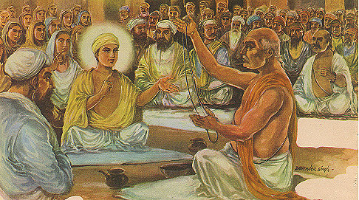
SALVATION - THE WAY TO GOD:
Gurmat rejects all fasts, rites and rituals as a means to attain salvation.
Rejects claims of yoga, mortification of body, self-torture and penances or renunciation.
Does not believe in the worship of gods and goddesses, stones, statues, tombs, crematoriums, Samadhies, idols and pictures.
Forbids the worship of anything of the Creation as a means to attain salvation.
Only one God, the Formless, the Creator of the world is to be Glorified.
Practice love,not hollow rituals

Slide 8
PRAYER
Human mind is full of five vices- lust, anger, greed, attachment and pride or ego.
These are the obstacles in the realization of Nam.
Purity of mind is needed for spiritual uplift. constant prayer and praise of God, will clean the impure mind.
The effect of Prayer and Praise is, firstly all the impurities of the mind are washed away and it becomes pure;
secondly as a result when the mind becomes pure, then the nectar of Nam enshrines the mind

Slide 9
PURPOSE OF LIFE:
According to the Guru, moral life is not a matter of a few commandments or a code or a ritual, but the fruit of a life directed towards spiritual quest involving incredibly hard discipline.
Most people generally believe in enjoying materialistic life to the brim..
Lured by the charm of success in this materialistic world, one gives little or no thought to the Eternal values of life

Slide 10
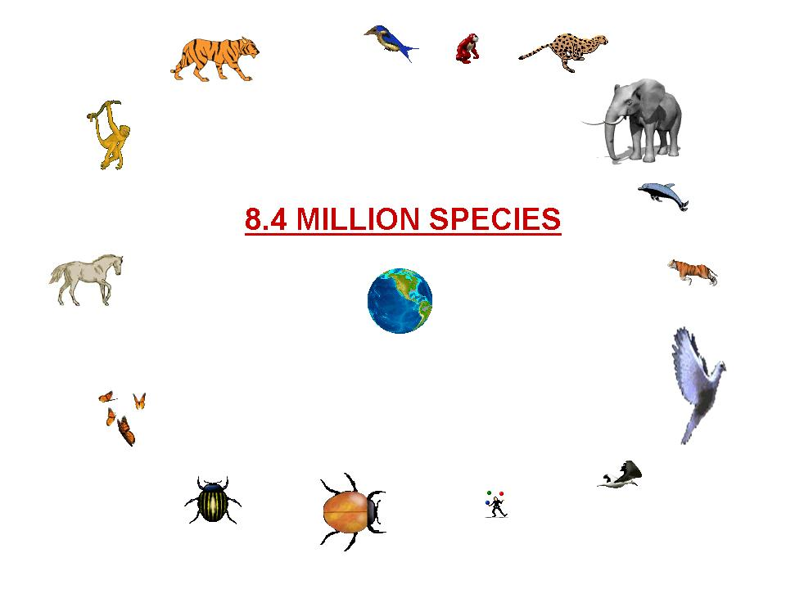
The Gurmat defines the purpose of life as:
"This time having born as human being
This is thy turn to meet the Supreme Lord.
Thy other activities will be of no avail at the end,
Seek the company of the holy men
And only contemplate on God.
Set thy mind on crossing the sea of life,
For life is being wasted away
In pursuits of pleasures of the world."

Slide 11
The purpose of human life in Sikhism is not to attain paradise or Swarga of the popular Hindu conception, but to seek God, and be united with Him.
The ultimate goal of Sikh religion is to merge with the Supreme Soul and then enjoy the Uninterrupted Bliss for ever.
A Sikh aspires for spiritual union with the Lord- a state of Bliss.
Human life is an opportunity to attain that goal, if it is missed, a person falls back in the cycle of birth and rebirth.

Slide 12
CONCEPT OF GOD IN SIKHISM:
The definition of God is given in the very opening sentence of Guru Granth Sahib, which is called Mool-Mantar (Preamble of Japji):
There is but One God
He is the Eternal Truth
The Creator, All-Pervading Divine SpiritUnfearful, Without hate and enmity
Immortal Entity, Unborn, Self-Existent

Slide 13
God is both Impersonal (Nirgun) and Personal (Sargun). Impersonal God is Formless and beyond the human reach.
When He reveals Himself through His Creation, He becomes related and personal. It is just like the rays coming out of the sun.
The source is Formless, and the whole universe is His Personal form.
No form howsoever unique it may be, is independent of Him. Infinite can manifest into unlimited number of finites, but any number of finites, alone or together, cannot be equal to the Infinite.
So any finite form cannot be worshipped as God, Who is Infinite and Formless:

Slide 14
DEVTAS-ANGELS
Reliance on mortals is in vain - know this well.
The Great Giver is the One Lord
Nothing at all is in the hands of mortal beings.
Understanding His Order, there is peace. .—GGS281
God Himself has created everything, He himself nurses them and destroys them as He wills.
Gurbani tells us not to bother about Satan, Brahma, Vishnu, Mahesh, Inder;
The poor fellows consider it to be lucky to have a chance to sing His praises standing at His door. Guru Granth P463

Slide 15
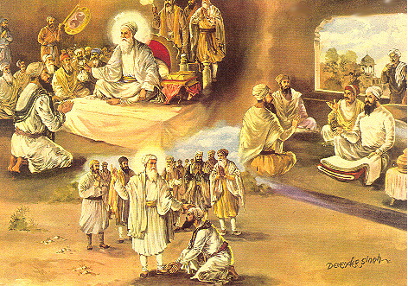
ARDAS
Praying to Him One can attain Comfort, peace and
Tranquility, wealth and the nine treasures
Beauty, intelligence, Wisdom, knowledge, and all spiritual powers ---GGS
Guru Amardas ji blessing Gangu shah who regained his material wealth and social status

Slide 16
'As you sow, so shall you reap', leads to the theory of 'Karma', actions, good or bad, where a person is rewarded for his good actions and punished for his bad deeds.
According to the theory of Karma, a worst sinner will always suffer for his deeds and can never attain salvation.
Guru Nanak has rejected this stating that pardoning even the worst sinner is the Sovereign Characteristic (Birdh) of God:
" (Bilawal Mohalla 5, p-829)
'Redeeming the repentant sinner, is Thy Characteristic.'

Slide 17
CONCEPT OF NAM (DIVINE NAME)
Nam is not expressed as mere noun and it does not mean that there is a special name of God and by enchanting of which, one will meet Him.
God may be called by countless names by the devotees, who create these names according to the attributes of their God
The word NAM is a mystic Word used in practical religious life and in discipline of meditation Such a mystic Word in Sikh religion is called 'Waheguru' Gurbani itself is Nam:
"Gurmukh bani nam hai, nam ridai vasaie."
(Sarang ki Var-pauri, p-1239)

Slide 18
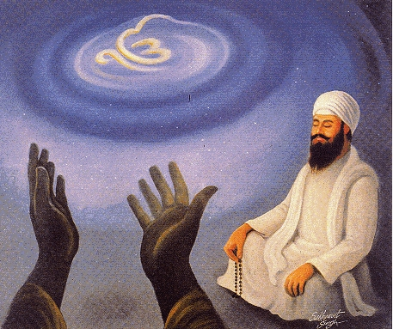
The term 'Nam Japo' means to remember God and to invoke His presence in one's conscious. All modes of meditation take the devotee into the presence of God, but according to Gurbani, Kirtan,, is the super form of meditation. It invokes one's consciousness to the maximum level, into the presence of God:
It is evident that any form of recitation of Gurbani, may be simple reading with attention and devotion or meditation on any Sabad of Gurbani or Kirtan, is fully deemed as Nam Japna (meditation on Nam), that is to invoke the presence of God in one's conscious.
"Har kirat utam Nam hai vich kaljug karni sar."

Slide 19
WHAT TO MEDITATE UPON OR HOW TO DO PRAISE AND PRAYER
A Sikh is to worship only One God and None else. But God is Formless, then what to meditate upon When we recite Gurbani, and if we do not know the meaning of the Sabad which is being recited, our meditation becomes mechanical, formalistic and hence futile.
Prayer with absent mindedness will not be acceptable to the Lord Attentive, alert and completely untainted mind is required for meditation.
Thus whenever we read, hear or sing Gurbani (Sabad), we must put our whole ATTENTION IN THE MEANING OF THE SABAD,
As our attention of mind and Sabad become one, our mind starts taking the impact of the spirit of the Sabad and the result of this COMMUNION IS BLISS, PEACE AND EVERLASTING JOY.

Slide 20
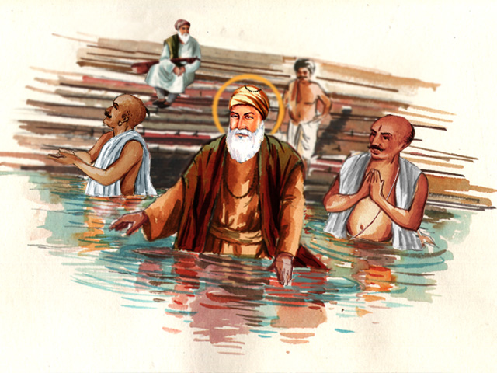
PILGRIMAGES- Bathing at Holy Places
A great deal of emphasis on rituals had been the way of Indian religious life for the millions before Guru Nanak appeared on the scene. Wherever Guru Nanak went, he tried to emancipate the masses from the shackles of superstition and ignorance, and instil faith in One All-Pervading and Formless God.
The Guru asserted that mere bathing at these sacred places, would not cleanse the mind riddled with the impurity of egoism
Worthless is that pilgrimage. I see in the whole world around That nothing can be gained without right action." Japji

Slide 21
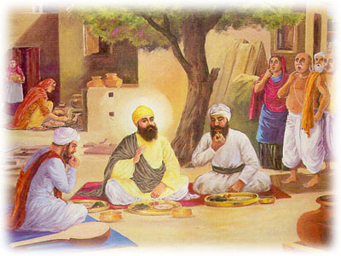
CASTE SYSTEM AND SOCIAL EQUALITY
, Guru Nanak taught equality and brotherhood.
The Guru rose above rites and rituals, above creeds and conventions, above all national-cults and all race-cults, to a vision of the deeds of love.
He preached a religion of love, sacrifice and service.
Complete equality among men was declared as the fundamental moral principle required to regulate the social relations and communication.
HOLY PERSON IS ONE WHO ACCEPTS ALL PEOPLE AS HIS CLASS MATES ; HE CONSIDERS HIMSELF AN EQUAL MEMBER OF BIG CLASS OF HUMANITY;GGS 6

Slide 22
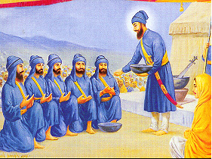
The tenth Master, Guru Gobind Singh, declared caste a taboo in the order of the Khalsa. In Akal Ustat, he states," There is no consideration of caste or membership of varnas.".
The theory of separate duties for different castes was replaced by the same ethical and religious duties for all men.
Therefore, the fundamental equality of all men was ensured by free and voluntary admission into the order of the Khalsa.
The first of the Sikhs baptized into the order of the Khalsa belonged to different castes

Slide 23
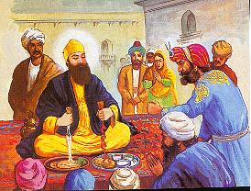
Social Equality
Wealth also provides a determinant of social classes as against birth in the case of caste system.
In Sikhism the relation among classes based on economic resources is envisaged in terms of equality.
It rejects the notion of superiority of the economically better placed class over others. The Guru says:
The man who knoweth God looketh on all men as equal, As the wind bloweth on the commoner and the king alike." Gauri Sukhmani Mohalla 5
Guru Nanak refused a rather sumptuous dinner of Malik Bhago for the ordinary bread of the coarse grain of Bhai Lalo

Slide 24
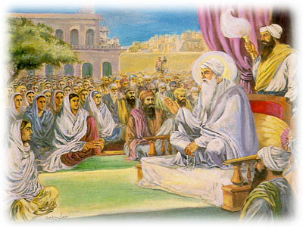
STATUS OF WOMEN
In Sikhism it is considered preposterous to regard woman a 'temptress' or 'seductress' or 'unclean'.
The Guru does not regard 'woman' as an obstruction on the way to ultimate goal of Eternal Bliss.
Guru rejects asceticism or renunciation as the requisite pathway, and regards the house-holder's life if it is led in a righteous manner, superior to that of an ascetic.
Guru stressed that women should be given honorable status in every social segment of the society.
NO GENDER BIAS

Slide 25
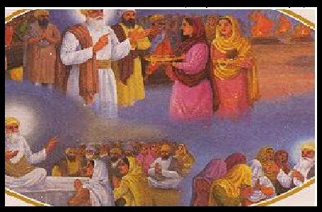
Guru Nanak asserted that women were not at all inferior to men In the moral codes of the Sikhs a large number of injunctions deal with the rejection of unethical practices like- (i) female infanticide; (ii) immolation of the widow (Sati) with the deceased husband, and (iii) wearing of veils by women.
Guru Amar Das, the third Master, carried out a vigorous campaign against this practice of Sati, and thereby he emancipated the women from this social oppression and religious cruelty.

Slide 26
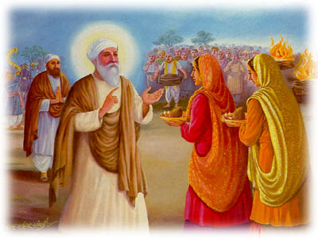
One of the most notable social improvement was the emancipation of women.
Many women found salvation through the Guru's teachings
.Guru Amardas ji appointed women as preachers called Manjis or head of sangat
In Sikhism widow remarriage is also permitted whereby the widow can be rehabilitated if she so desires.
WIDOW REMARRIAGE

Slide 27
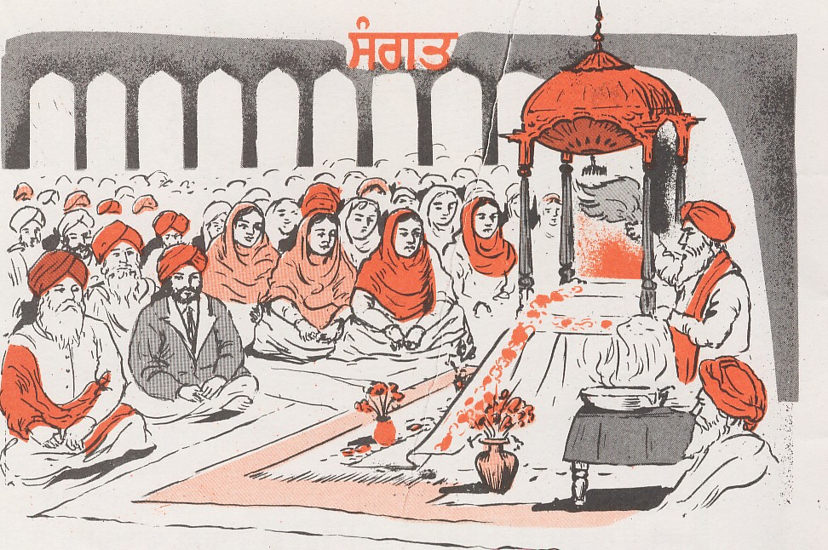
SANGAT AND PANGAT:
SANGAT- Society of the Holy: means assembly or congregation, but in Sikhism Sangat is usually called Sat Sangat (holy congregation) which may be defined as the Home of Truth where people love God and learn to live in Him:
It is well recognized fact that spiritual progress cannot be achieved without the company of the Holy. The society of the holy is the means of destroying egoism and helps one in freeing oneself from evil passions
"Sat Sangat kaisi janiai jithai eko nam vakhaniai."

Slide 28
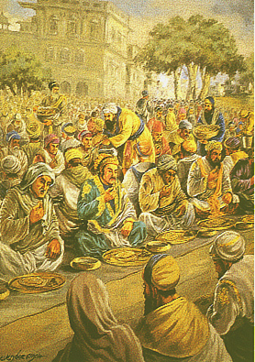
Guru's Free Kitchen known as Langar
It was initiated by Guru Nanak and its consolidation and extension was affected by the third Guru.
The rules of the Langar require that all should sit in the same row and partake of the same food without any distinction of high or low, rich or poor, and prince or the peasant.
people were made to renounce their social prejudices. Common kitchen also served as a medium of social integration.
When Emperor Akbar, came to see the Guru, had to sit with other common people and dine together with them before the Master gave consent to see them.

Slide 29
UNIVERSAL BROTHERHOOD
The ideal of social equality is not the ultimate aim of the ethics of Sikhism.
This equality may be maintained without feeling any affection or regard for each other, but such bare equality would not be enough because it does not conform to the ideal of humanistic morality.
Hence in order to make it whole, it should be saturated with the idea of spiritual unity of mankind

Slide 30
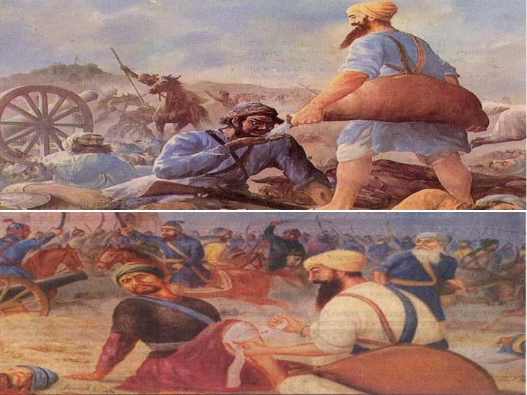
Once by the grace of the Guru, our heart is filled with divine light, then there is no 'other', there is no enmity, no hatred, but it is all altruism and service for the brotherhood of mankind.
Bhai Ghanaya.. Was forerunner of red cross movement
In the battlefield Bhai Ghanaya was on duty to serve water to the thirsty. He was found serving water to the Sikhs as well as to the Hindus and Muslims alike
There is no enemy, none is 'other', A sense of universal brotherhood has come to me." (Kanra Mohalla 5, p-1299)

Slide 31

SARBAT DA BHALA
Sikhism fully stands for universal brotherhood in word and in spirit. Every Sikh living in every corner of the world when he prays in the morning and in the evening, ends his prayer by saying:
"By Thy Grace, may every one be blessed in the world."

Slide 32
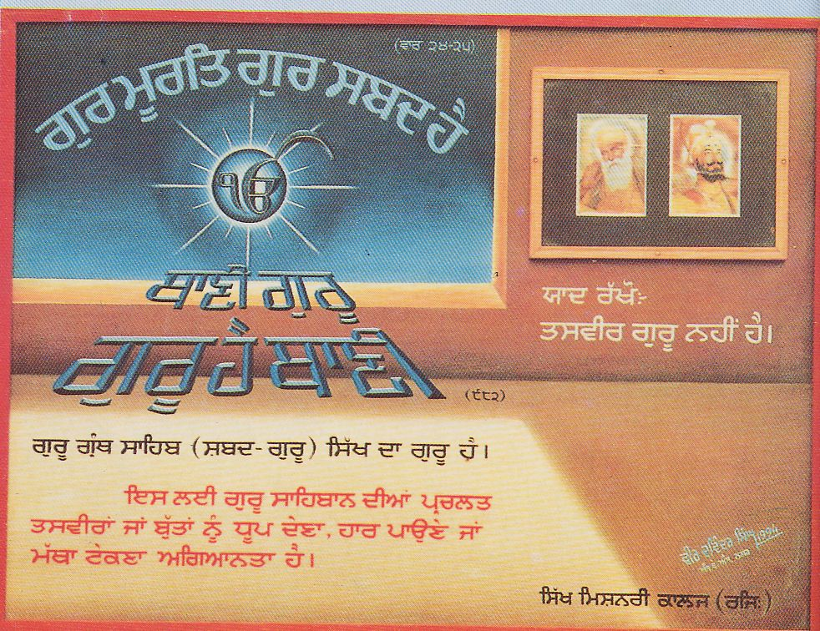
PICTURES OF THE GURUS:
From Guru Nanak to Guru Gobind Singh, emphasis was laid to worship only one God, the Formless, and they strongly forbade the worship of idols, crematoriums, tombs Guru's teaching explains that true Guru is not a physical body and therefore the body is not considered to be worthy of any kind of worship:
Therefore, the meaning of "Gur ki murat man meh dhayan" is clearly not the worship of Guru's picture but to put attention in the meaning of the Sabad (Word).
According to Gurbani Guru is not body (deh), Guru is Jot (Divine Light) and Guru's murat (picture) is the Divine Word
'Jot roop har aap gur nanak kahaio.'

Slide 33
Sikhism is not a dogma but a way of life lived according to Guru Rahit Maryada (code of conduct).
A Sikh has to hold his Guru's word as paramount in his daily existence. Without glorifying His presence in one's existence, life will be contaminated and polluted and will be in deplorable state which will lead to spiritual degeneration.
Deep and continuous contemplation on Nam is needed and is indispensable for the exalted state of Sikh character. Nam is neither a philosophy nor knowledge to be gained from books. It dwells within and is realized from within through the grace of the true Guru (Gurbani - Divine Word). Let the following be our daily supplication:
"O my friend, the Divine Guru! Illuminate my mind with the Name Divine! Let the Name revealed to me by the Guru be my life-companion; And singing Thy Glory be my daily routine."(Rag Gujri Mohalla 4, p-10)

